Slide 1
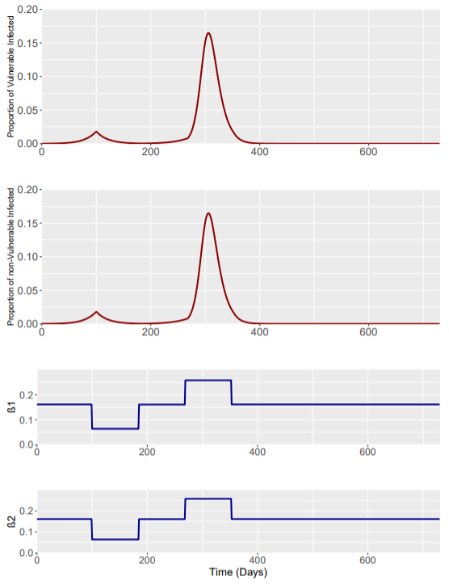
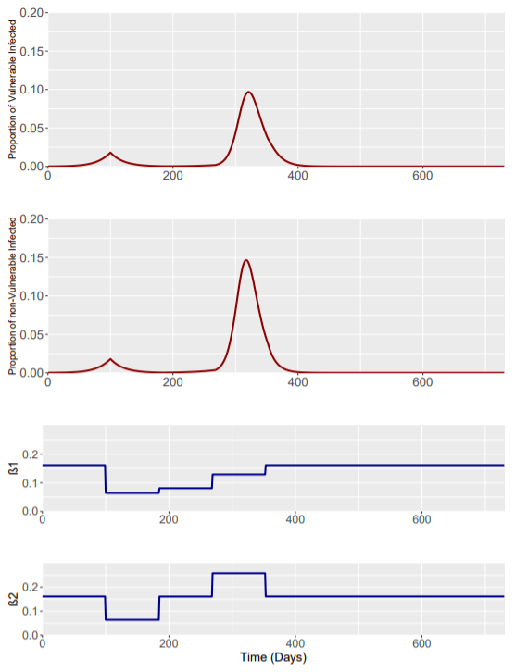
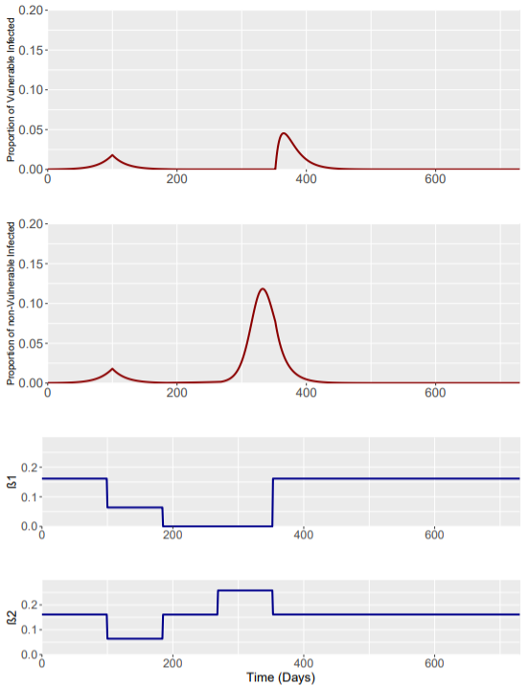
Phase | Weeks | Beta1 | Beta2
0 | Up to t=0 | 0.161 | 0.161
1 | 0-12 | 0.064 | 0.064
2 | 12-24 | 0.161 | 0.161
3 | 24-36 | 0.258 | 0.258
Phase | Weeks | Beta1 | Beta2
0 | Up to t=0 | 0.161 | 0.161
1 | 0-12 | 0.064 | 0.064
2 | 12-24 | 0.081 | 0.161
3 | 24-36 | 0.129 | 0.258
Phase | Weeks | Beta1 | Beta2
0 | Up to t=0 | 0.161 | 0.161
1 | 0-12 | 0.064 | 0.064
2 | 12-24 | 0 | 0.161
3 | 24-36 | 0 | 0.258

